Slide 1



Business Game : Group 9
ATHAR Muhammad Wasif
BELKORCHI Nafissa
SAIPOVA Maftuna
ZOLLI Amandine
Financial reporting and analysis – 2022-2023

Slide 2
Quick overview of

Slide 3
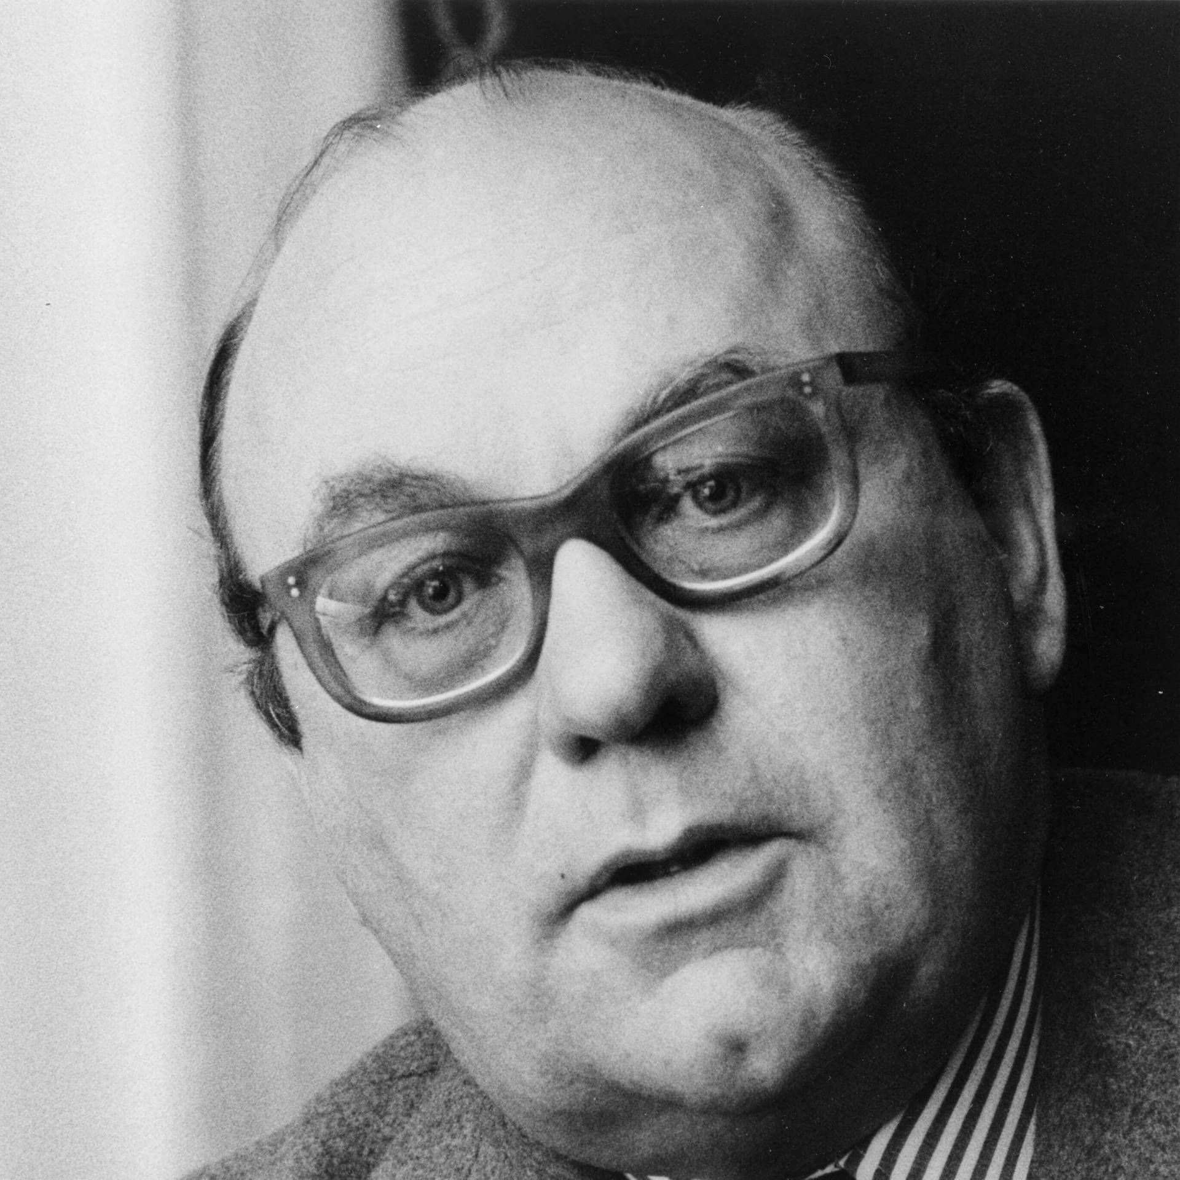
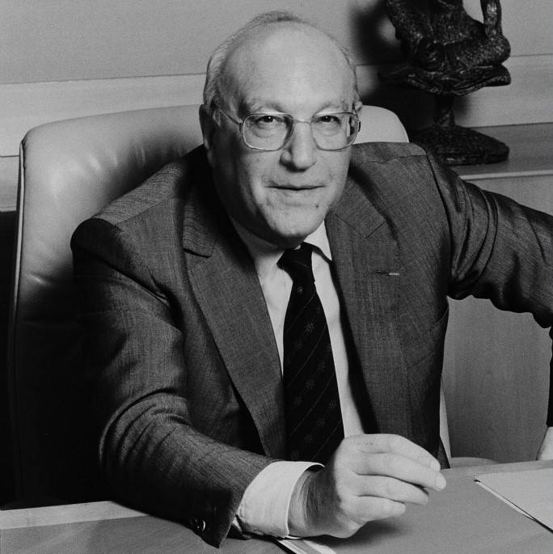
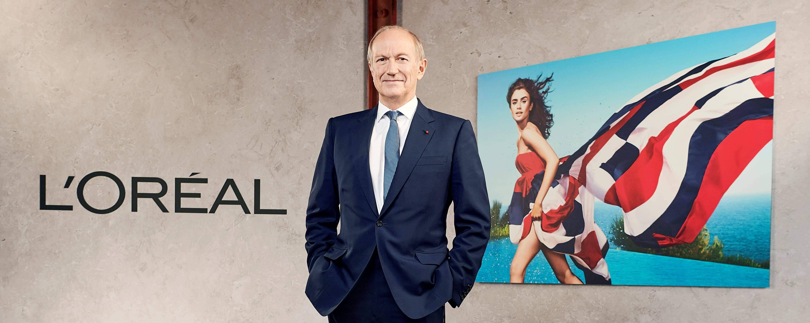
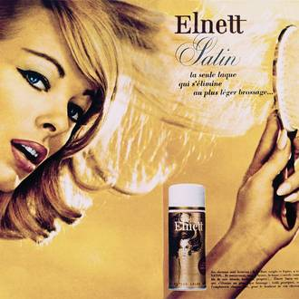

History of the target company
The first step, constructing a model
Beauty is a scientific adventure
Diversity of Beauty worldwide
1909-1956
1984-1987
2006-Today
1957-1983
1988-2005
On the road to the Grand L’Oréal
Become number one in the beauty industry

Slide 4
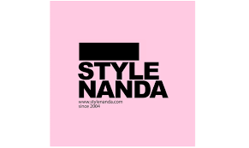

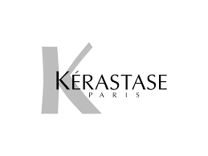
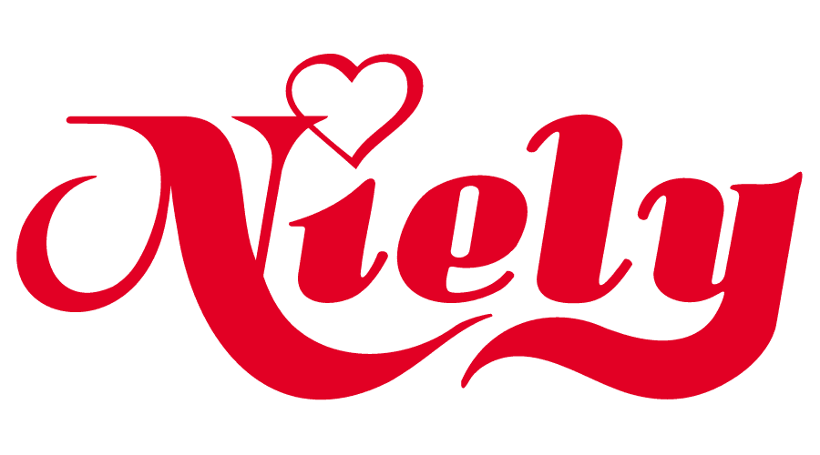

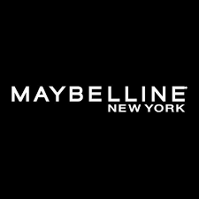


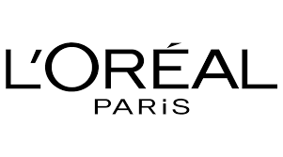



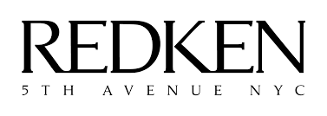
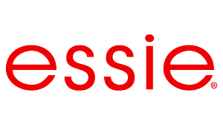

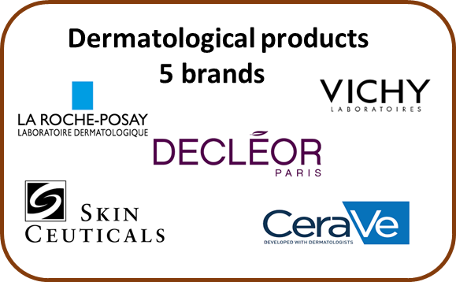
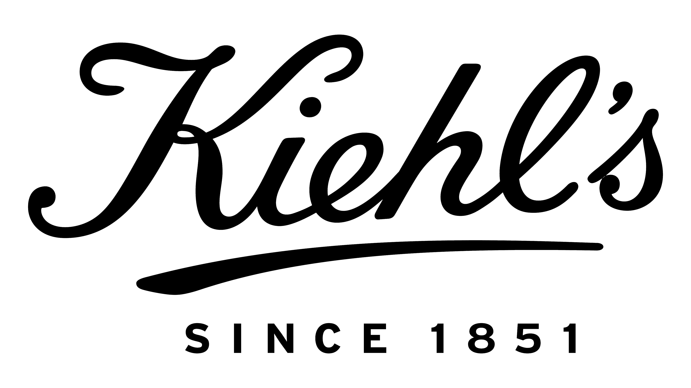


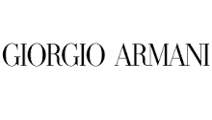

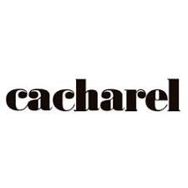

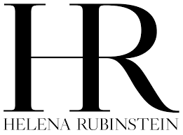
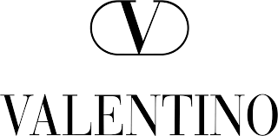



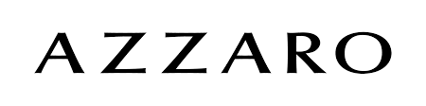
Professional products 5 brands
Consumer Product 9 brands
The segmentation of the group
Luxe +20 brands

Slide 5
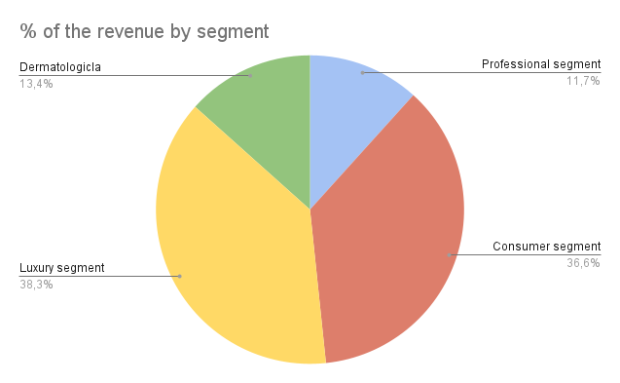
Revenue generated by segment

Slide 6
Sales trends

Slide 7
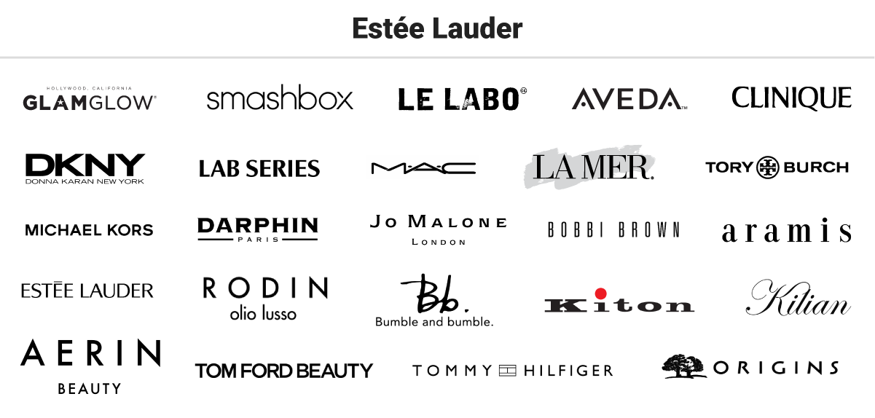
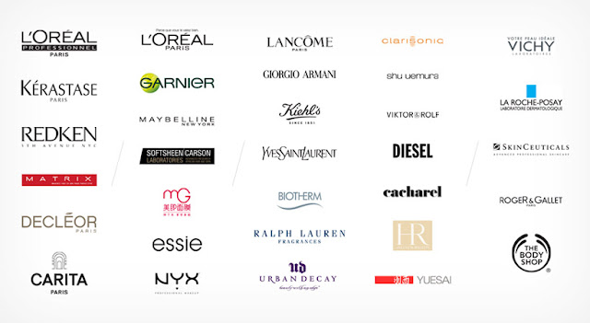
Profitability Analysis
Both companies are specializing in manufacturing consumer goods such as cosmetics, perfume and goods for health and beauty, also both are distributors. Both are operating throughout the world.
However, it is important to note that L’Oréal has twice as much employees as Estee Lauder does, 85,000 and 44,000 respectively. And revenues of L’Oréal in 2022 comprised 38 bln euros while revenue of Estee Lauder were far less comprising $17 bln.

Slide 8
Profitability Analysis in Comparison
Ratios/Margin | L’Oréal | Estee Lauder
Gross Profit Margin | 72,35 % | 70,87%
EBIT | 7547 € | $ 1473
ROA | 12,2 % | 5,4%
ROE | 22,30% (median) | 22,91% (median)
ROCE | 22,78% | 9,55%

Slide 9
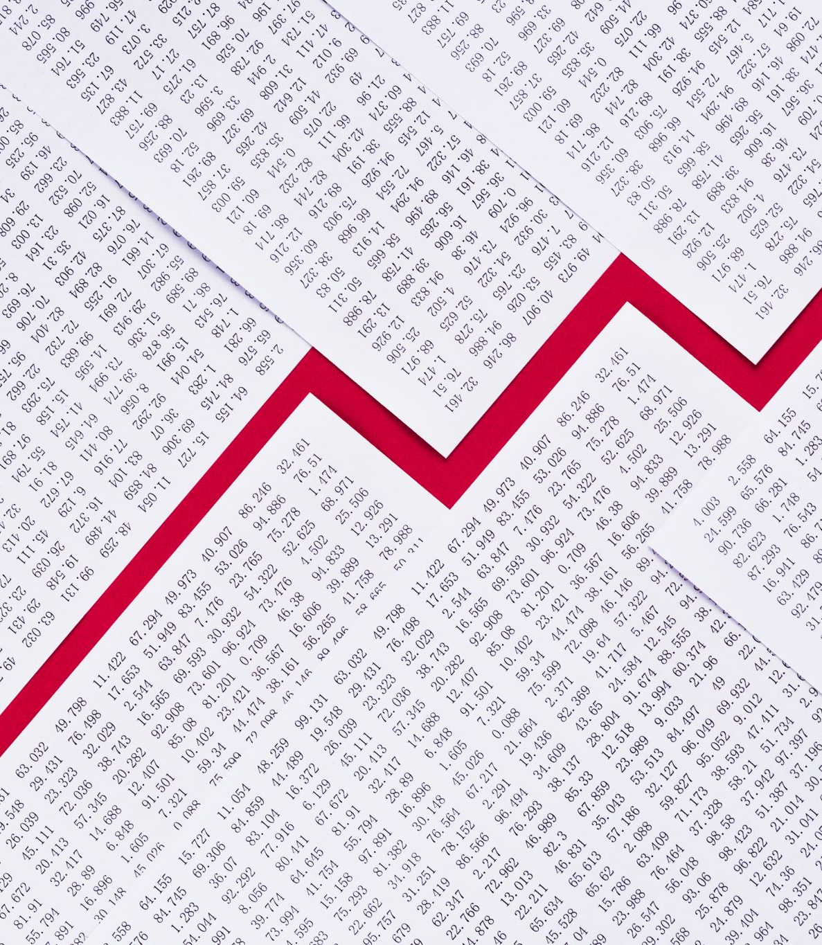
Analysis of significant financial statement items

Slide 10
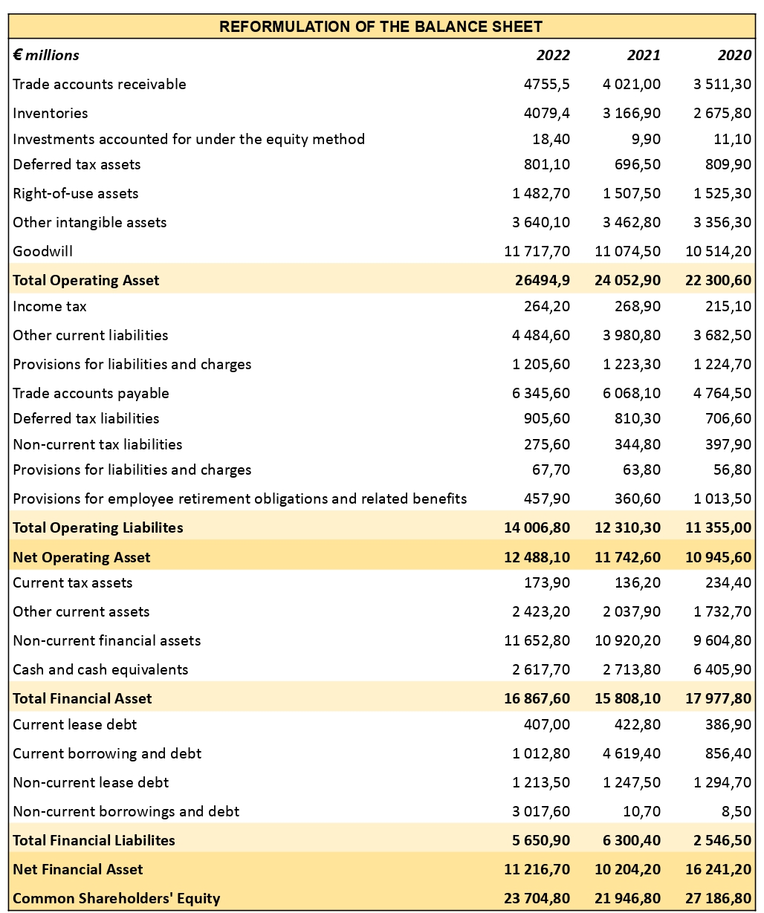
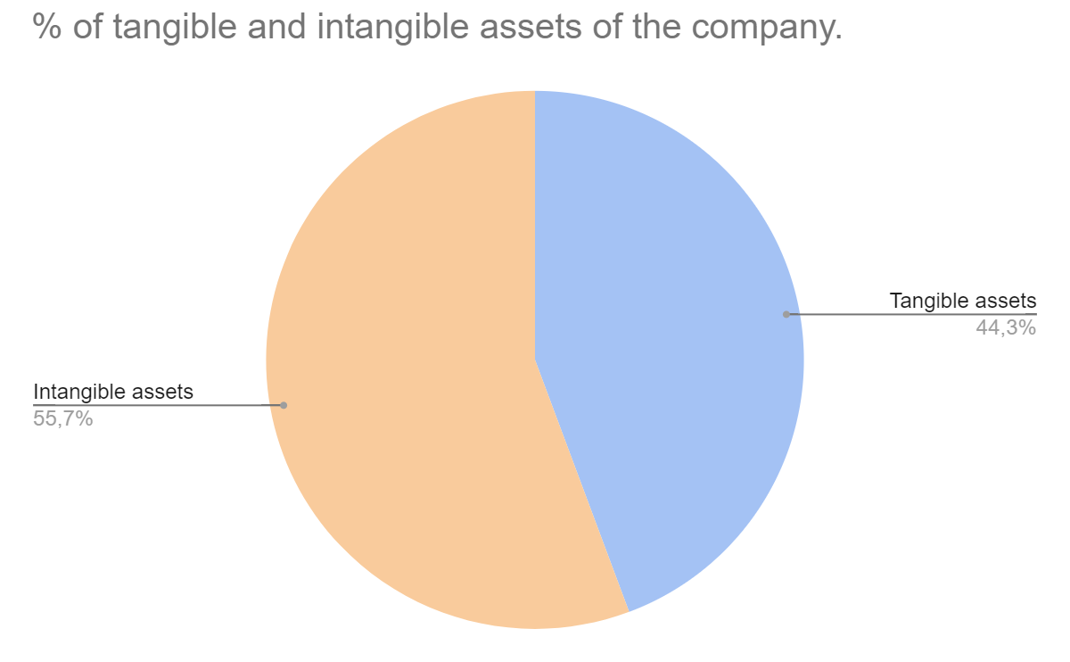
Reformulated Balance sheet
(Excluding non-current financial asset)

Slide 11
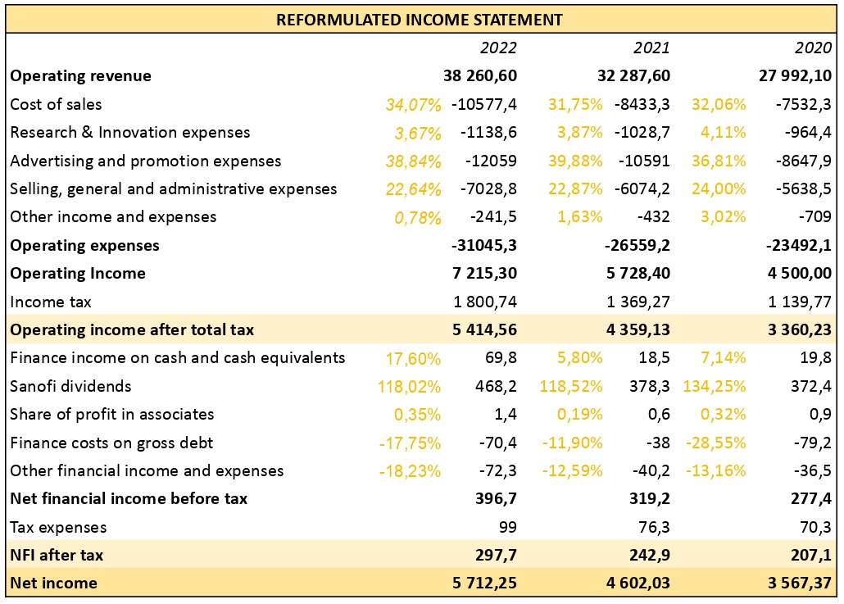
Reformulated Income Statement

Slide 12
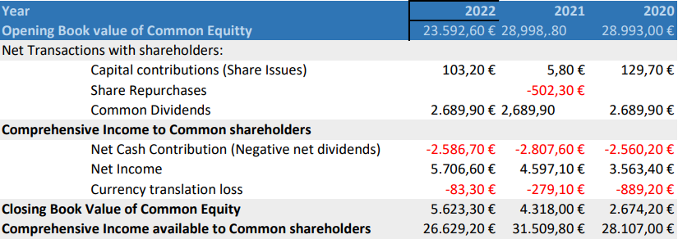
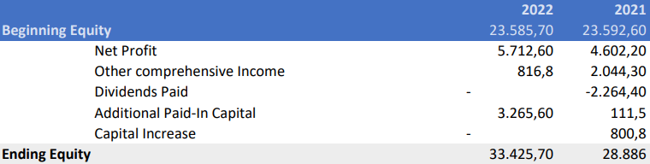
Reformulated shareholders equity statements

Slide 13
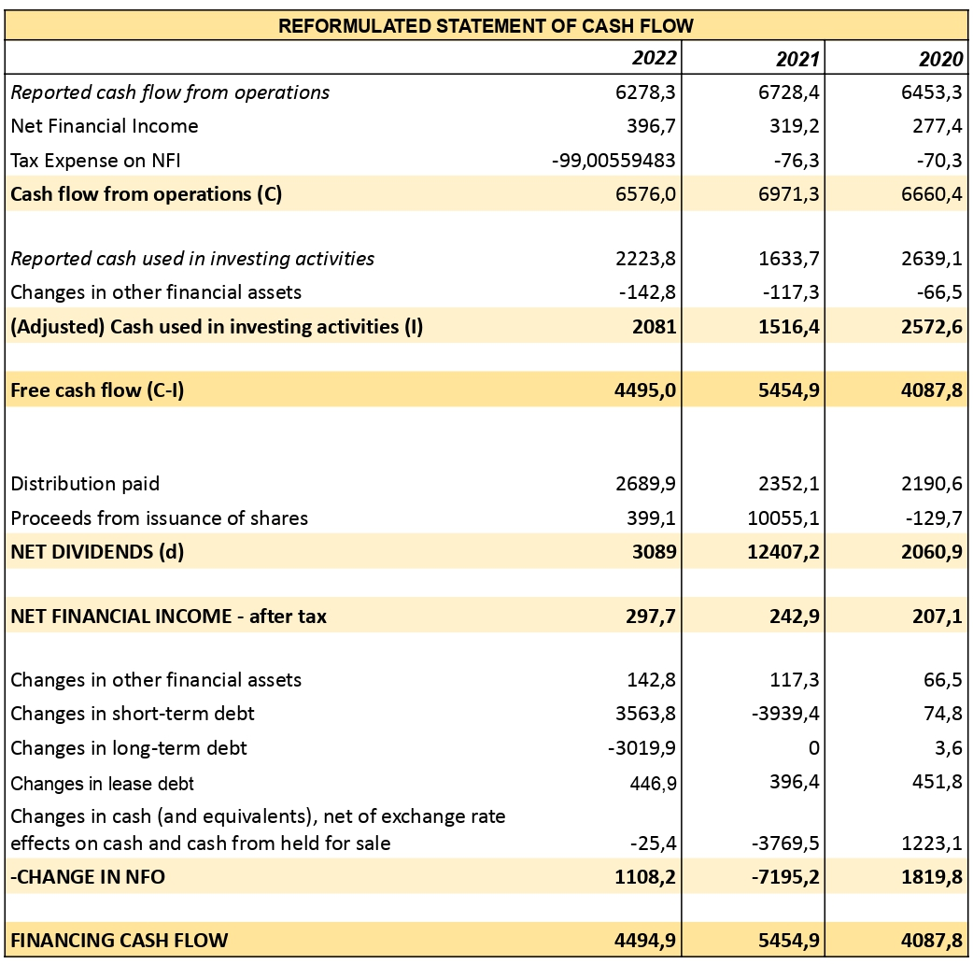
Reformulated Statement of Cash Flow

Slide 14
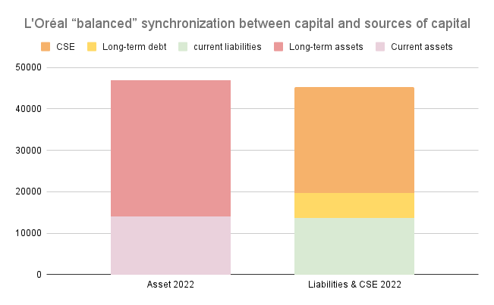
Credit analysis
 | 2022 | 2021 | 2020
Current ratio | 1,024 | 0,728 | 1,308
Quick ratio | 0,727 | 0,537 | 1,068
Cash ratio | 0,380 | 0,295 | 0,752
Days in Account Receivable | 42
Days in Inventory | 125
Days in Account Payable | 230
Cash Conversion Cycle | -63

Slide 15
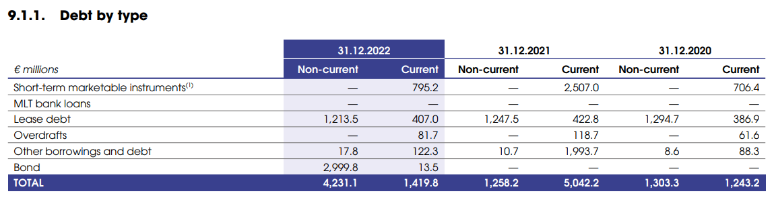
Credit analysis
 | 2022 | 2021 | 2020
Debt-to-Total Assets | 12,06% | 14,65% | 5,84%

Slide 16
Credit analysis
For the period 2020-2022:
Interest Coverage*: 103,35
Multiple Discriminate Analysis : Z-score =7,892 >2,99
Credit score : AA for S&P and Aa1 for Moody's
*(Times Interest Earned)

Slide 17
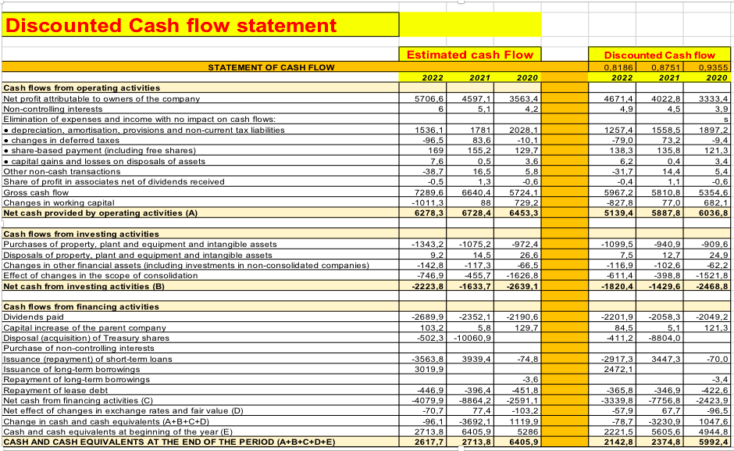
D C F
Property, plant, and equipment required significant capital investments, leading to negative cash flows from investing operations.
Shareholders received dividend payments, and different effects were felt from capital gains and treasury share trades.
Cash flows were impacted by the repayment of short-term debt and the mixed issuance and repayment of long-term debt.
Each year, the change in cash and cash equivalents was negative, meaning less cash was available.

Slide 18
Discounted Cash Flow statement analysis:
The company's net profit attributable to owners climbed steadily, rising from €3,333.4 in 2020 to €4,671.4 in 2022.
Non-controlling interests stayed constant, fluctuating between €3.9 in 2020 and €4.9 in 2022.
Net cash generated by operational operations declined significantly from €6,036.8 in 2020 to €5,139.4 in 2022.

Slide 19
Multiples
 | 2022 | 2021 | 2020
P/E | 31,32 | 50,60 | 48,79
P/B | 6,60 | 9,90 | 6,02
P/S | 4,69 | 7,23 | 6,24
P/CFO | 28,57 | 34,69 | 27,05
 | L’Oréal | Industry Median
Trailing P/E (12 months) | 36.75 | 35.51
Forward P/E (12 months) | 34.06 | 27.56
Trailing P/B (12 months) | 8.37 | 3.30
Trailing P/CFO (12 months) | 32.81 | 14.35
(from Refinitiv)

Slide 20

Recommendation to the BoD
Encourage employee share ownership:
Improvment of profitability, liquidity, and solvency ratios by highlighting the important financial performance indicators.
Promote sustainable growth
Effective corporate governance.
Issuing integrating pay practices with the company's long-term performance goals

Slide 21

Thank You for your attention.

